Slide 1
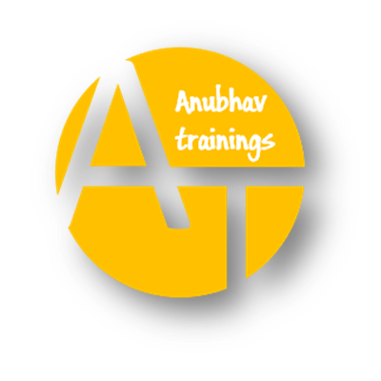
SAP BTP ABAP on Cloud / RAP Training
DAY-09
Anubhav Oberoy
www.AnubhavTrainings.com
Follow excellence with sheer passion

Slide 2

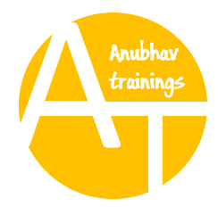
DISCLAIMER
The training content and delivery of this presentation is confidential, and cannot be recorded, or copied and distributed to any third party, without the written consent of Anubhav Trainings

Slide 3

01
Introduction to CAP
02
Create CAP Application
03
Deploy Application to BTP

Slide 4
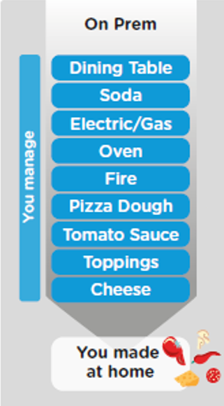
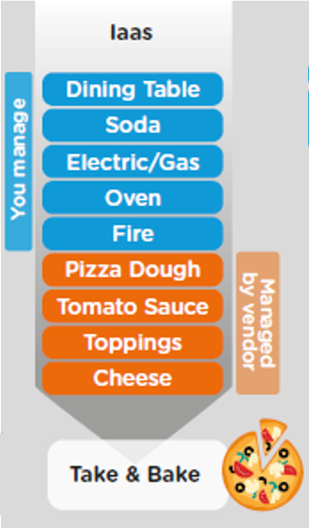
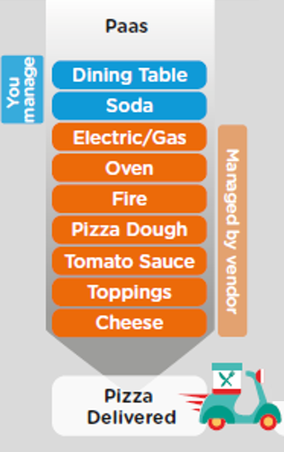
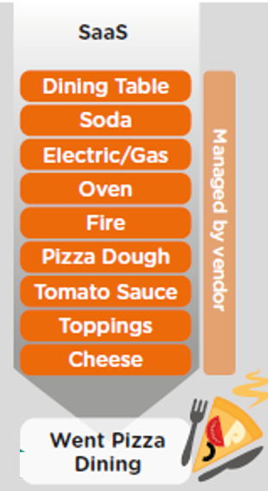
ON-PREMISE V/S CLOUD
www.anubhavtrainings.com

Slide 5




WHAT IS SAP CLOUD FOUNDRY?
Application
Application
Data
Data
Runtime
Platform as a Service
Managed by SAP implementing open source CF
Middleware
Fully ready landscape with reusable services
Scalability
Elasticity
Low TCO
Database
OS
Managed by Infrastructure
providers
Data Centers
Service Portfolio
Virtualization
Infrastructure as a Service
Servers
Storage
Networking
www.anubhavtrainings.com

Slide 6
What is SAP BTP?
SAP BTP is a PaaS (Platform as a Service) for developers where we can design, develop, package, test, deploy, integrate, and manage end to end applications. Top IT companies are the customers of this platform.

Slide 7

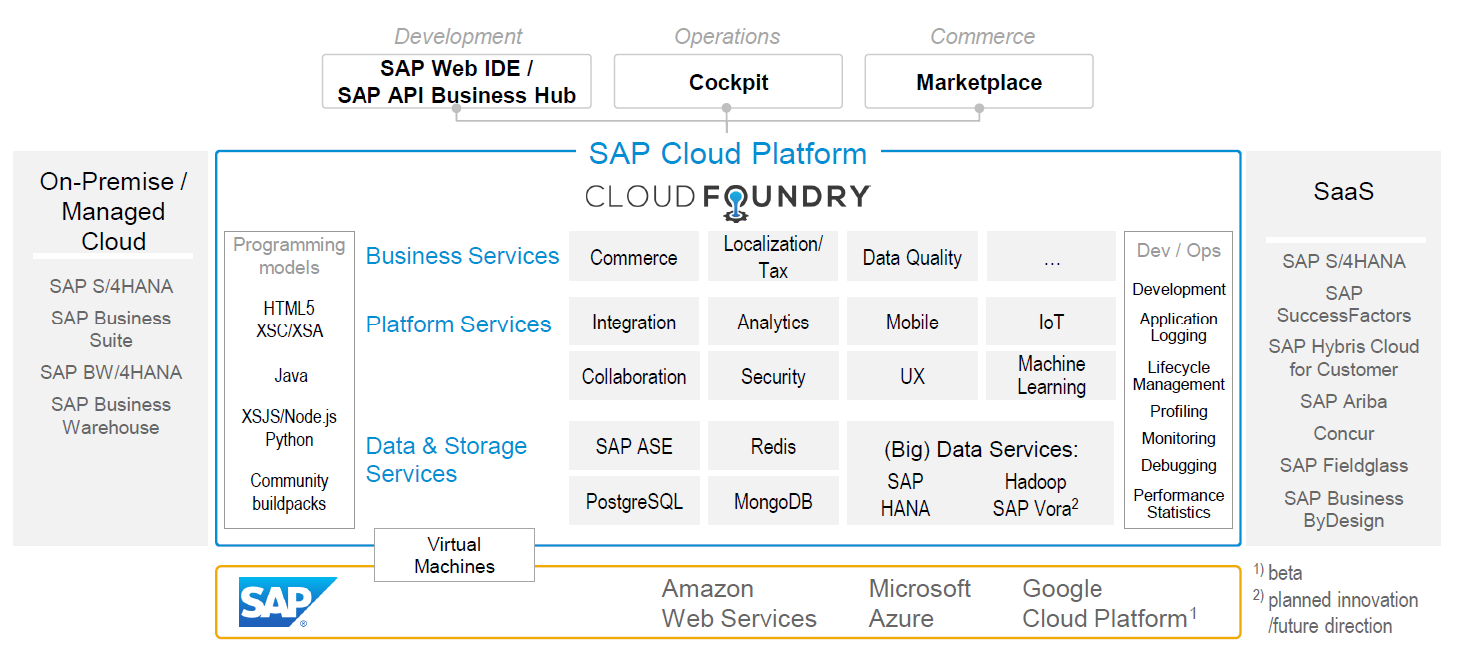
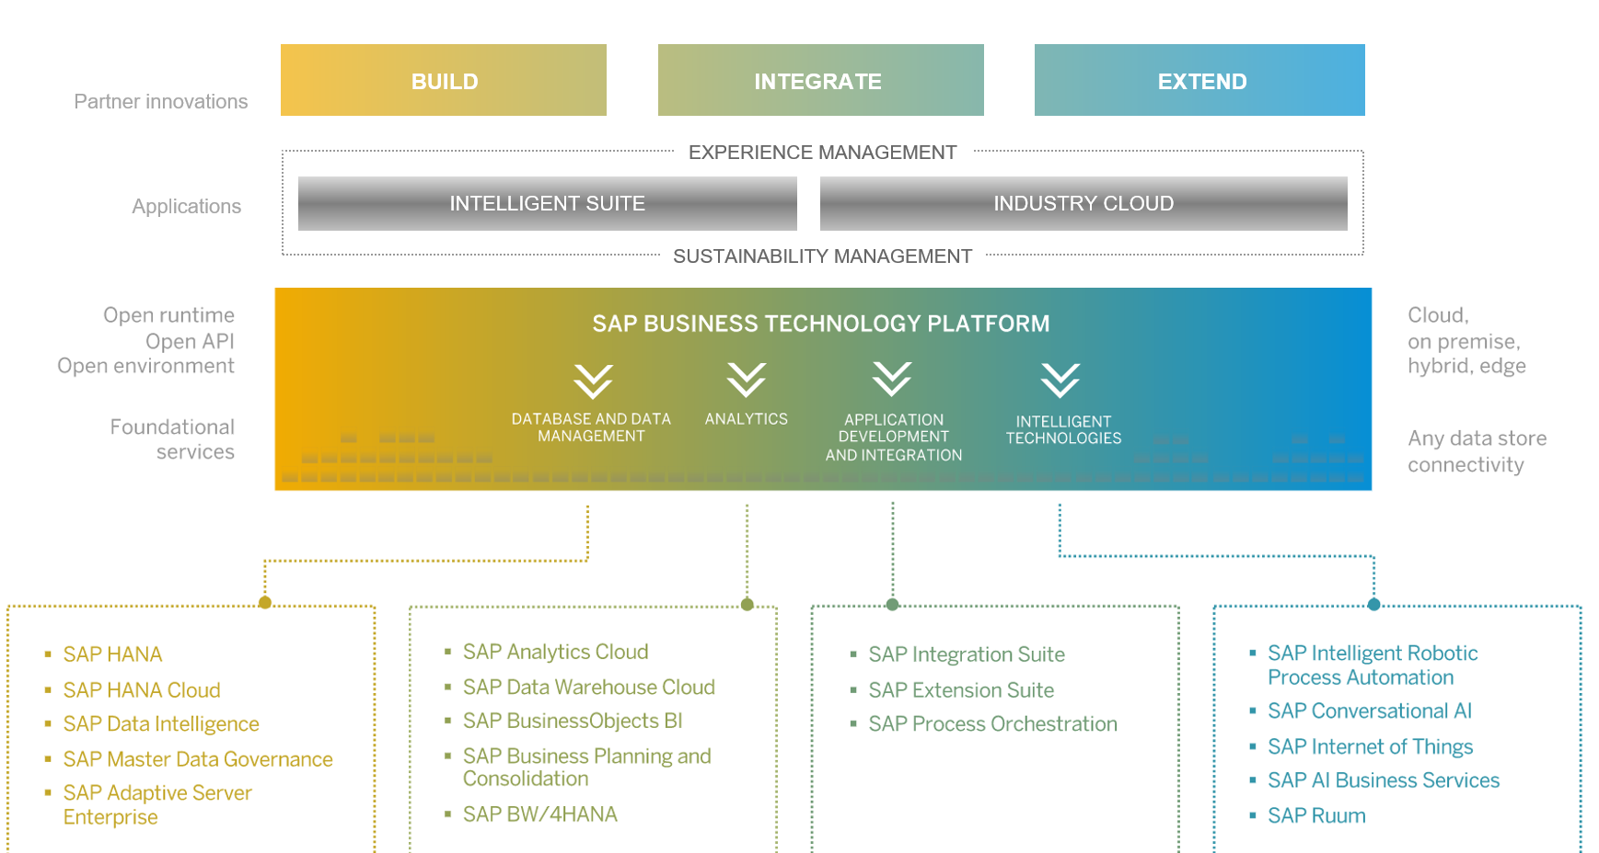
SAP BTP Overview
11
www.anubhavtrainings.com

Slide 8
SAP CLOUD FOUNDRY ARCHITECTURE
SAP Business Application Studio
www.anubhavtrainings.com

Slide 9
Setup - Customer View
Backing Services
Global Account
(Representation of customer for billing purpose)
Sub Account
(per region)
Specialized service offerings
Represents LoB
Space quotas
1 *
1 *
Space
1
*
Apps
www.anubhavtrainings.com

Slide 10
BTP Environments, Subscriptions, Services
Environments
Environments constitute the actual platform-as-a-service offering of SAP BTP that allows for the development and administration of business applications. Environments are anchored in SAP BTP on subaccount level.
SAP BTP offers three environments: ABAP, Cloud Foundry and Kyma. Some existing customers still have Neo, but this is no longer offered.
Subscription based services
You will also see these ones called software as a service (SaaS), or multitenant applications. The experience here is that you subscribe to the service, and in return you receive a URL, from which you can access that service. Opening the URL brings you to a web application from which you can leverage the service. This is how other SaaS like SuccessFactors or S/4HANA Cloud work as well. They are also enabled at a subaccount level and are independent of the environments.
Examples include Launchpad (new Build workzone), SAP Business Application Studio, Integration Suite, Build process automation.
Instance based services
These are the purest services. They provide a specific functionality, like databases, connectivity, authentication…. You connect your application to them to leverage that functionality. These services don’t provide a UI to manage them. Instead, they rely on API to connect to applications and other services and provide their services. They are provisioned inside an environment, so they are environment specific. Each environment has its own organization (for users and applications): In Cloud Foundry, instances are created inside a space. For Kyma, instances are created inside a namespace.
11
www.anubhavtrainings.com

Slide 11
Micro Service Architecture
In software engineering, a microservice architecture is an architectural pattern that organizes an application into a collection of loosely coupled, fine-grained services that communicate through lightweight protocols. This pattern is characterized by the ability to develop and deploy services independently, improving modularity, scalability, and adaptability.
Monolithic – classic ABAP based development. Entire application is build together, package together, deployed together. If there is a change in application, whole application will be built and deployed again. The scalability is hard to achieve. E.g. SAP applications on ECC. Systems are poorly utilized. Due infra limitations, we cant have 24X7 availability.
Question: in my company we use SAP, there are 100s of transaction code, but we use most of the time VA01 alone, is it possible to increase RAM memory only for VA01?? – No
On weekends no one is available to use SAP system, So can we bring down the RAM size of SAP?
Microservice – The entire application is broken down into small-small services. Each service is independently developed, packaged and deployed w/o tight coupling. So this brings elasticity and scalability.
11
www.anubhavtrainings.com

Slide 12
Use Cases – Microservice - Uber
Passenger App
Driver App
Driver App
Passenger App
20GB
Payment Gateway
Location API
Location API
60GB
100GB
Payment Gateway
15GB
How many people search for cabs – 10,000
How many of them actually book – 5,000
How many drivers accept – 4,800
Cashless payment - 800
5GB
Pros – maintenance cost comes down, elasticity (best technology), scalability (up,down)
Cons – experience, inter service communication is tricky
When we use CAPM development, we are naturally using MS architecture.
11
www.anubhavtrainings.com

Slide 13
Node JS
Node JS is a open source framework to offer the JS runtime. It can be installed on any platform (win, mac, linux), open source, free, very good for data intensive applications. A develop who does web development using JavaScript can easily now code on server side using node js. It is also called as server side java script.
Java Script
Java and Java Script are completely different programming languages in their design, purpose and usage. You don’t need to learn Java at all to learn Java Script. JS is a light weight programming language which is free. It is easy to learn, it is asynchronous non blocking programming language. It can be used to
Build business logic (processing logic)
Perform database lookups
Perform data exchange
Build excel, pdf
Send emails
11
www.anubhavtrainings.com

Slide 14
NPM – Node Package Manager
Node package manager is like a hotel manager which brings all the dependencies for you. When we build a software, we are living in 21st century, we don’t want to build every part of the application ourself (don’t reinvent the wheel), we have powerful frameworks, tools, libraries, reusable modules so you can import them and build on top of it to save time, money and effort.
When we use node js, we often get common requirements e.g. pdf, excel, mail. We get the reusable node modules on node eco system – https://npmjs.com
To install any module from node eco system, we can do it 2 ways
Install node module globally (if we want to CLI to be installed)
npm install -g <module>
2. Install node module at a project level
npm install <module>
Also help us to initialize a node project using npm init command. It will create a package.json file which contains all our application properties. So a developer can come back in future to know the project properties like id, version, author, dependencies on the modules etc.
11
www.anubhavtrainings.com

Slide 15
Cloud Application Programming Model (CAPM)
CAPM is a framework - a collection of libraries (reusable), tools, which include classes, methods, attributes, events etc. to fulfil the needs of a reusable component helping developers to follow standardized practice to build Applications.
Languages – Node JS and Java
Libraries – node modules - @sap/cds-dk , @sap/cds
Tools – VS Code, BAS (Business Application Studio)
https://cap.cloud.sap/docs/get-started/
CDS – Core Data & Services
Conceptually CDS is same concept but different flavor. The concept says that, we will have a design time object (which developer is coding) – a .cds file. We will create .cds file for almost everything (db, service,ui) and this design time object is compiled by the CAP engine (@sap/cds) after compilation, it will create the runtime object.
CAPM engine
(@sap/cds)
App Project
Runtime object (code)
.cds file
11
www.anubhavtrainings.com

Slide 16

@sap/cds-dk
DK – Development Kit
It is a node module which is part of CAPM framework and should be installed globally in your workstation if you are using VS code else if we use BAS, its already installed and pre-configured.
It offers a CDS command line interface which help developers to quickly scaffold (initialize) our capm projects, build capm projects, add dependencies, run locally, deploy to btp.
npm install -g @sap/cds-dk
cds -v
If you are using your company laptop and do not have permission to install these modules, node js, switch to BAS tool w/o wasting time.
11
www.anubhavtrainings.com

Slide 17
Association
It represents the relationship between entities. It is like foreign key relationship as we do in ABAP. Typically, association is a lose coupling, both the tables can have independent records, it is should have relationship.
Composition
It is a tight coupling, where both the tables are connected mandatorily. If there is no data in table1, there will never be corresponding data in table2. if we delete record from table1, all the dependent records of table2 gets deleted (cascade).
e.g. Sales order and sales order items.
Cardinality – tell us how the records of each table connects to each other. 1..1, 1..n
11
www.anubhavtrainings.com

Slide 18
Generic handlers
As we see that, the CAPM framework has already created default implementation for CURDQ, As a developer if we want to add extra bit of functionality, we can opt for generic handlers. The generic handlers are special functions which we need to define and implement, so that CAPM can invoke them at certain point. Its like injecting our custom code on, before or after the CAPM execute the standard code.
Generic Handler
Fiori
OData
CAPM
Sqlite DB
before
on
after
this.on/before/after(‘OPERATION’, Entity, (req) =>{ req.data })
https://cap.cloud.sap/docs/node.js/core-services#srv-on-before-after
11
www.anubhavtrainings.com

Slide 19
Functions and Actions
Functions and actions are non-standard operations in CAPM. Unlike the standard CRUD, they are used to run domain specific operations. These can be instance-bound or non instance-bound. Instance bound actions and functions will always receive the primary key value as a input and added to cds file next to the entity.
Functions are side-effect free because they never tend to modify, delete, add new data to database. Functions always have a return data in their implementation and called with GET call. Actions are called using POST call, have ability to update, delete, create data in server.
CDS QL – CDS query Language
While implementing functions and actions, we as a developer can interact with database using safe-api provided by SAP CAPM framework. This API allows us to write simple json based calls to DB, without writing SQL query. So the code will work in future even when database changes.
https://cap.cloud.sap/docs/node.js/cds-ql#into
Case 1: Get the most expensive order in whole system.
Non instance bound function
Case 2: Implement a special boost operation which increase my order value by 20000
Action, instance-bound
Using CAPM and Mongo DB with AWS
https://www.youtube.com/watch?v=zXZf8kKM9NA&list=PLcxqFaocb9WLaza2kOjkUCDIQGbzNos6p&index=47
11
www.anubhavtrainings.com

Slide 20
Authentication v/s Authorization
Authentication – Is a process in application security to ensure that is the user valid? Does he/she who is connecting to our application have done a login and successfully pass the login mechanism of our application. Usually authentication is achieved by a simple login screen which can be a custom screen, or preferably with an IDP (Identity provider). These IDPs are configured in SAP BTP subaccount under the security tab.
Authorization – Once the user is authenticated, then the authorization comes into the play. It ensures, that our user who is already logged-in have the necessary permissions to access the parts and functionality of the application. This is often done by role management. E.g. create, update, delete, approve, reject.
In SAP BTP environment, the complete security is controlled by 2 major components
IDP – Identity Provider
XSUAA – XS –eXtended Services, UAA – User Account and Authorization
11
www.anubhavtrainings.com

Slide 21
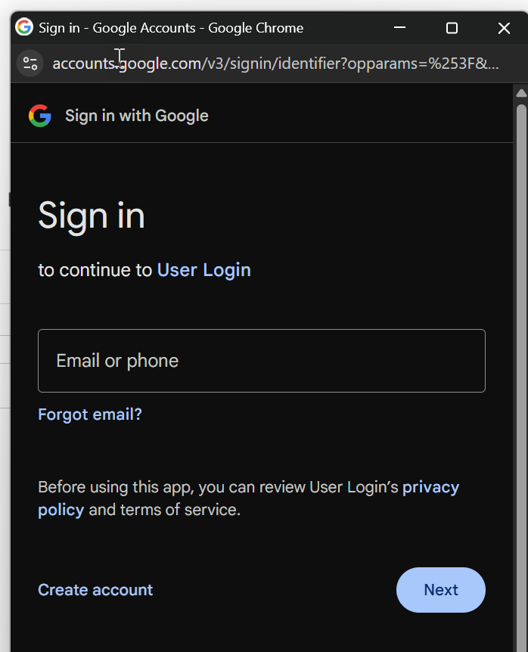


Identity provider
It ensures the login mechanism. It offers a login screen to the user.
Centrally stores all the users and their credentials
When a user leave company, we just need to delete/block user from IDP, they will be blocked from all company apps
It simplifies the login process, user don’t need to remember password for every app like SAP systems, Outlook, portal, ESS, SRM apps, launchpad.
Single source of truth about all the users in our company often also include their position in company.
Companies often buy the ID service and configure their login screens with their logos.
E.g. SSO, Google IDP, Linkedin IDP, Meta IDP, X IDP
SAP Systems
browser
token
Fiori Launchpad
token
login
Portal
IDP
trust
SRM
Outlook
Users, passwords, personal, position
BTP CAP App
11
www.anubhavtrainings.com

Slide 22
XSUAA – User Account and Authorization
Since we as a SAP developer do not want to learn how every IDP works differently and their respective documentation, SAP offers a special built-in component called XSUAA in Cloud Foundry environment. The XSUAA offers below:
It communications for us with IDP maintained in the trust configuration in our BTP account
It will redirect our BTP application request to IDP automatically
It ensures the security of all our BTP applications
It manages our application security, but as a developer our CAPM app, we need to inform the XSUAA, hey XSUAA, these are the permissions of my custom app.
As a developer we need to write a security configuration file in our BTP CAPM App which contains the required permissions which as a developer we need for our functionality. We do it using a file called xs-security.json
The file must follow the format as per SAP guideline - https://help.sap.com/docs/btp/sap-business-technology-platform/application-security-descriptor-configuration-syntax
Usually you can simply define and start with some basic permissions like Viewer, Editor, Approve and Reject (smallest level of permissions you want to apply to your app – called as scope)
We need to also create a role template using these scopes, one role template can contain multiple scopes (equal to an authorization object)
Additionally we can also control row level permissions using properties (called attributes)
Accept the SAML token from IDP, and after verification issues a CF specific auth token called JWT token (JSON Web Token)
xs-security.json
Role template
(A skeleton to create final role in BTP account later on which defines the collection of permissions)
Scopes
(granular level permissions)
*..*
Attributes
11
www.anubhavtrainings.com

Slide 23
Mta.yaml – Application Deployment Descriptor
This is a special file which is an advance version of manifest.yml to describe about our microservices which are part of our project. It contains the entire project details, version, type etc. along with
Modules – contain all the multiple microservices like DB, App, Srv etc. which could be built using many different technologies like html5, nodejs, java, db.
Resources – list of backing services (instance based services) required by our microservices (modules) to run application in btp.
For our current app
Db deployer module – responsible to create a new container which is central for all the end users. It will use the hdi microservice (like mickey) at runtime to interact with db and deploy our db artefacts. Start-deploy-stop
Node js CAPM based SRV module – which contains the information about cap application where the runtime is node js, responsible to offer the odata services for CURDQ operations as microservice in cloud. It also use the hdi microservice as resource to communicate with HANA Cloud. Also there will be one more resource of type xsuaa backing service which pick the xs-security.json file from our project and inform XSUAA about roles which we need for our app.
11
www.anubhavtrainings.com

Slide 24
App Router
A node application which we as a developer needs to implement in our cap project. It takes care of all the redirection between IDP and XSUAA
It also bring the JWT token from XSUAA and gives it to our individual services inside our app
Provide a single entry point for entire application so our user wont get confused with microservice architecture
It is built using a standard module called @sap/approuter
All the interservice communication will also be taken care by the app router
Steps
Go to the app folder – cd mycapapp/app
Run the npm init command to initialize a new project, which creates a package.json inside app folder
Install approuter dependency – npm install @sap/approuter - https://www.npmjs.com/package/@sap/approuter
When the app is deployed to BTP cloud, the approuter should start automatically, for that we provide the start script
"start": "node node_modules/@sap/approuter/approuter.js"
Just add a webapp/index.html as a sample UI so we can test the same
Now we need to add the configuration to inform the approuter about our end points of the app, create a file under app folder called xs-app.json , you can read documentation here
11
www.anubhavtrainings.com

Slide 25


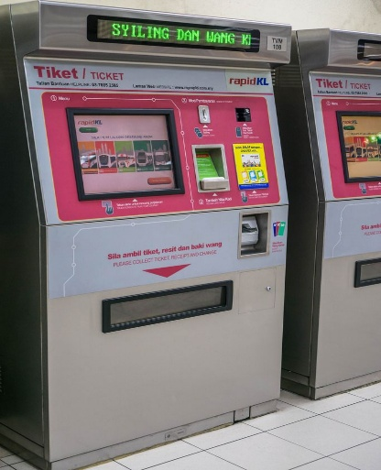
Real Life Example of App Router
Anubhav
Representative
Locker
FDs
<<verify>>
Loans
Securities
**********
Insurance
11
www.anubhavtrainings.com

Slide 26
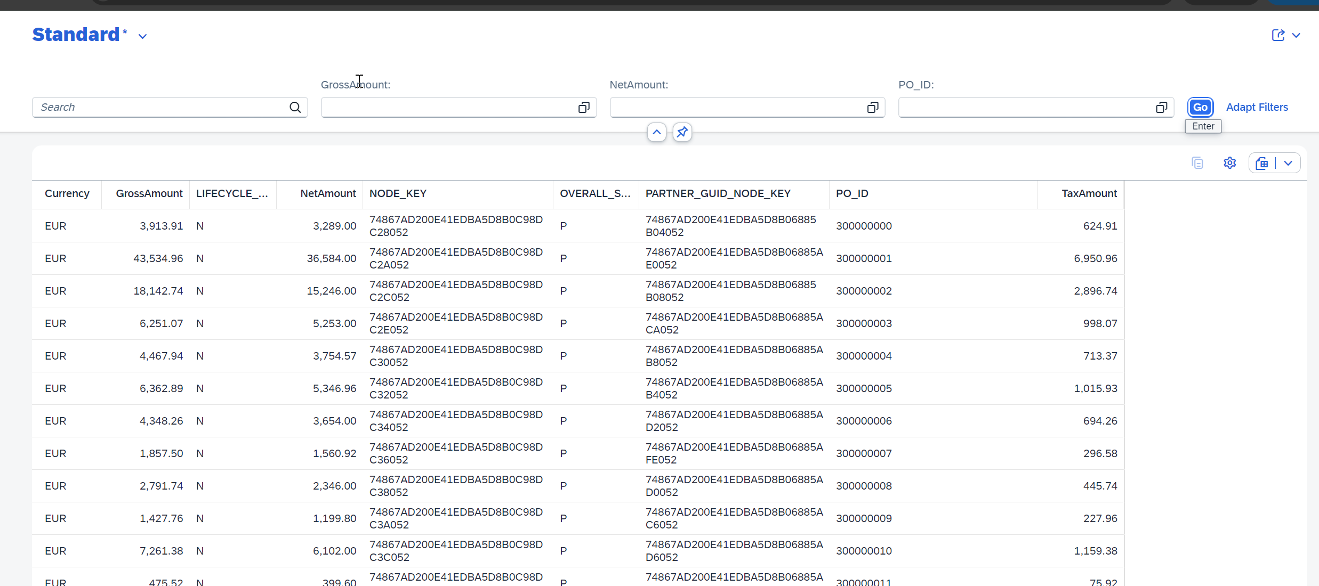
Selection Fields and Line Items
<content>
@UI.selectionField
@UI.LineItem
11
www.anubhavtrainings.com

Slide 27
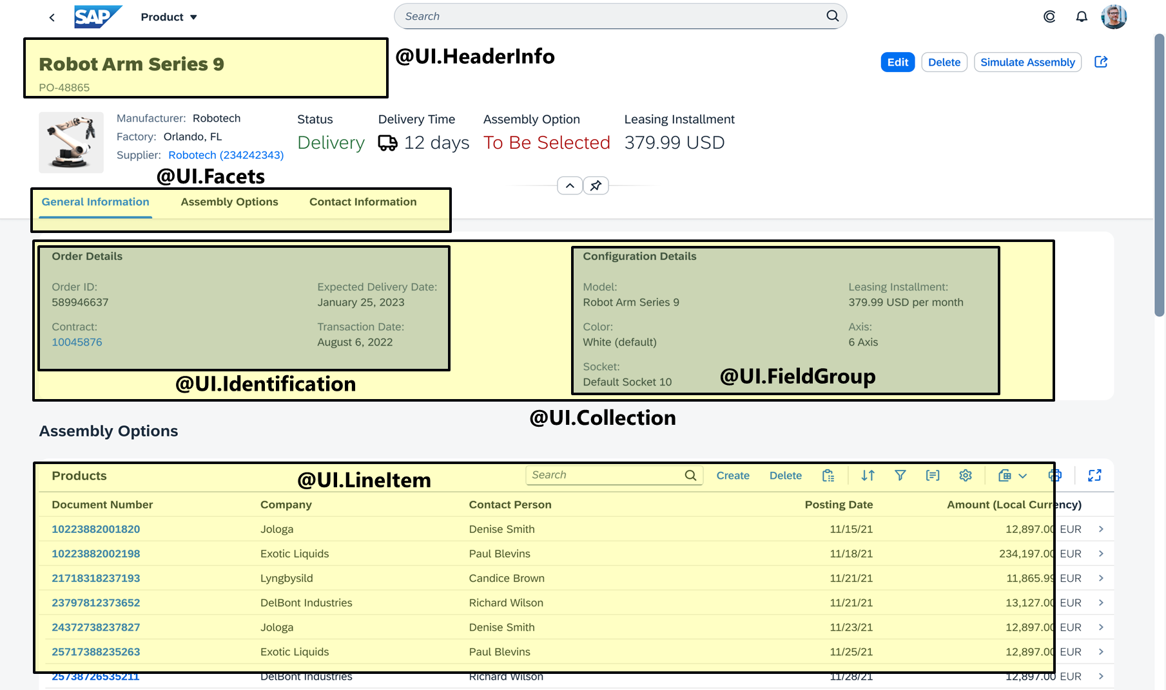
Object Page
<content>
11
www.anubhavtrainings.com

Slide 28
www.anubhavtrainings.com
Thank You
End of Day 09
www.anubhavtrainings.com

Slide 29


We’re committed to empower you to be
#FutureReady
through powerful training solutions.
We build the workforce of the future.
250+
Corporate Clients
30,000+
Learners Trained
25000+
Learners Placed
FREE WEBINARS
Sign up for free webinars with industry experts every fortnight!
Enroll Now!
Contact us today!
https://anubhavtrainings.com

